Slide 1
Car accident severity
prediction model

Slide 2
Introduction: Business understanding (Problem)
We live in a world where a lot of statistic that directly affect road transportation are publicly available, these statistic include weather reports, visibility, cohesion on certain days or dates, and so on.
These statistics are used to design a model which uses the available statistics in order to predict the likelihood of an accident happening.
Since almost everybody finds themselves on the road almost everyday, this model is targeted to everyone. so when every a person wants to go out, they can check and see if it is safe for them.

Slide 3
Data Understanding
The dataset used contains data about car accidents provided by SPD and recorded by Traffic Records. I contains 40 columns, 39 of which are independent variable and a target variable 'SEVERITYCODE' which will be predicted.

Slide 4
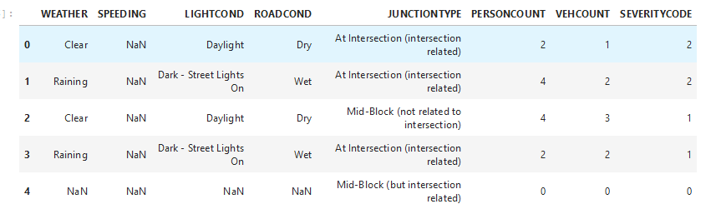
The Data

Slide 5
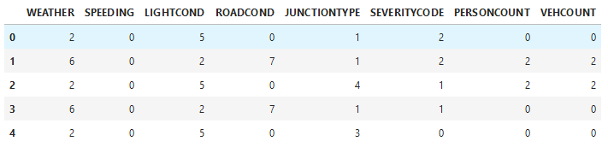
Data After encoding

Slide 6
The Models

Slide 7
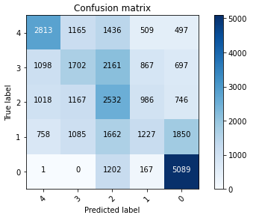
K nearest neighbor
Train set Accuracy: 0.41885570824524315
Test set Accuracy: 0.411993217203638

Slide 8
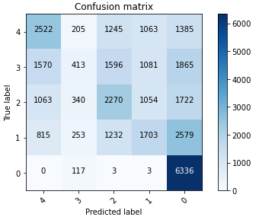
Logistic Regression
Accuracy: 0.40832434098967163

Slide 9
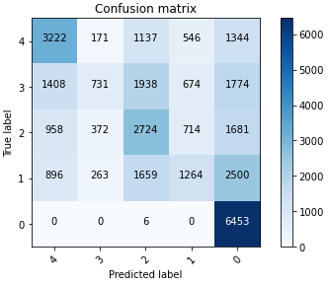
Support Vector Machine

Slide 10
Evaluation/Result
 | Score | F1 Score
K nearest neighbor | 0.412 | 0.396
Logistic Regression | 0.408 | 0.356
Support Vector Machine | 0.444 | 0.393

Slide 11
Discussion
After training three different models, the k nearest neighbor had an accuracy of 41.2% and an F1 score of 0.396, the Logistic regression model had an accuracy of 40.8% and an F1 score of 0.356 while the SVM had an accuracy of 44.4% and an F1 score of 0.393.

Slide 12
Conclusion
The models trained above are a way of predicting whether or not the will be a collision on a certain day given the conditions. For cases where there will be collision, the model goes further to predict how severe the collision would be. This model is great and useful to a lot of people.

